Slide 1
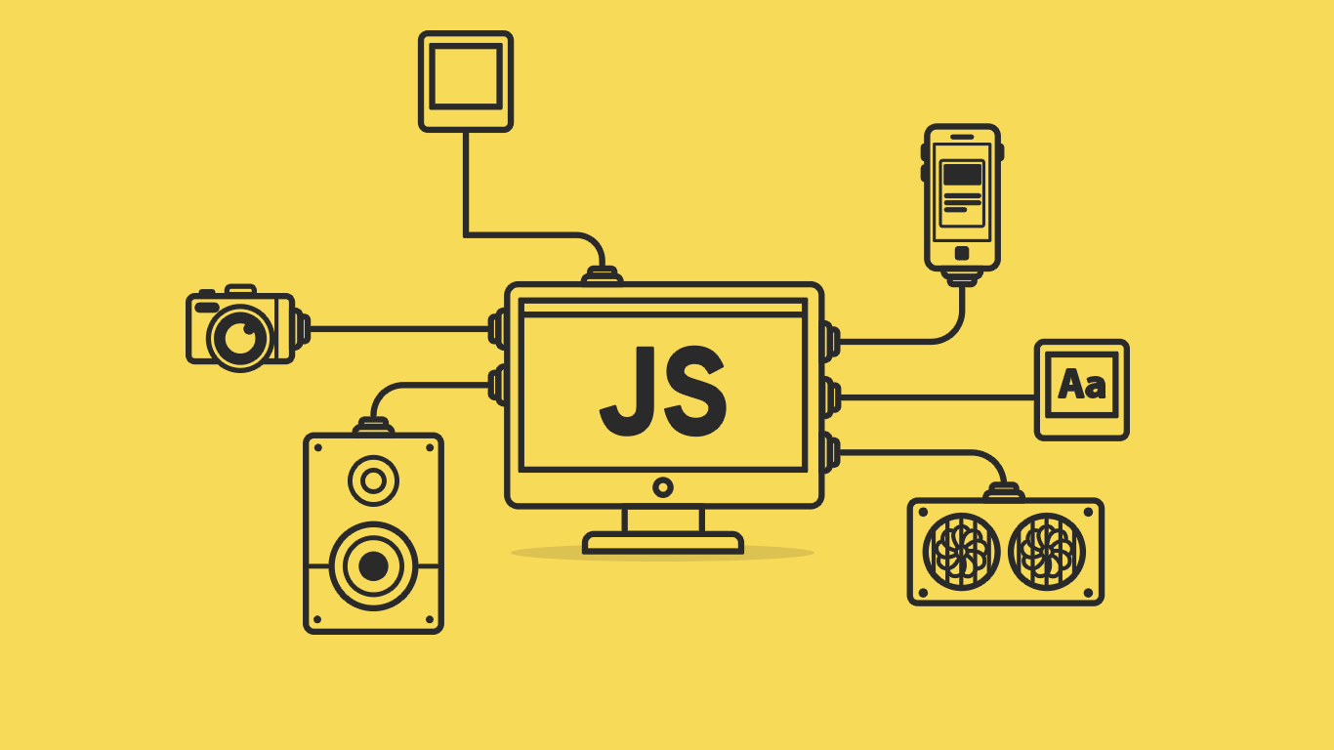

Slide 2
About today…
Functions
Function parameters
Return statement

Slide 3
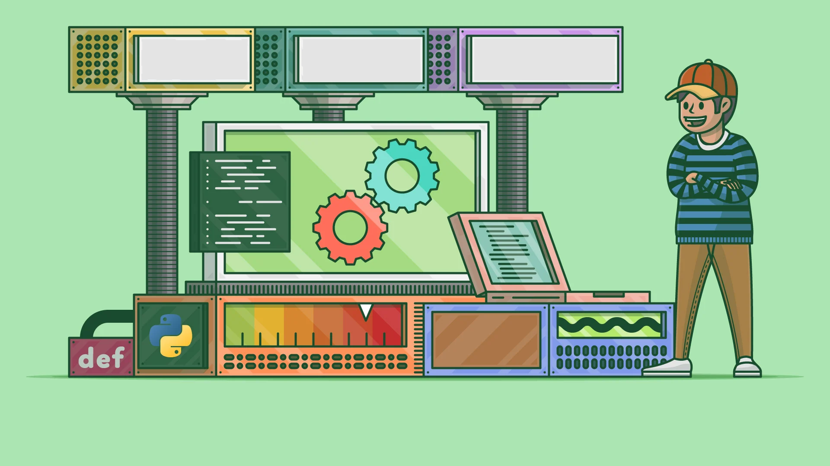
FUNCTIONS

Slide 4

Introduction to Functions
Definition
A function is a block of code designed to perform a particular task
Key Point
Fruits Array
Functions are executed when they are called (invoked)

Slide 5

Functions
Reusability
Write code once, use it multiple times
Maintainability
Easier to manage and update code
Fruits Array
Modularity
Breaks down complex problems into simpler pieces
Abstraction
Hides complex logic and provides a simple interface

Slide 6


Creating Functions
function
Keyword to define a function
greet
Function name
Parenthesis ( )
Used to include parameters (if any)
Curly braces { }
Enclose the function body

Slide 7

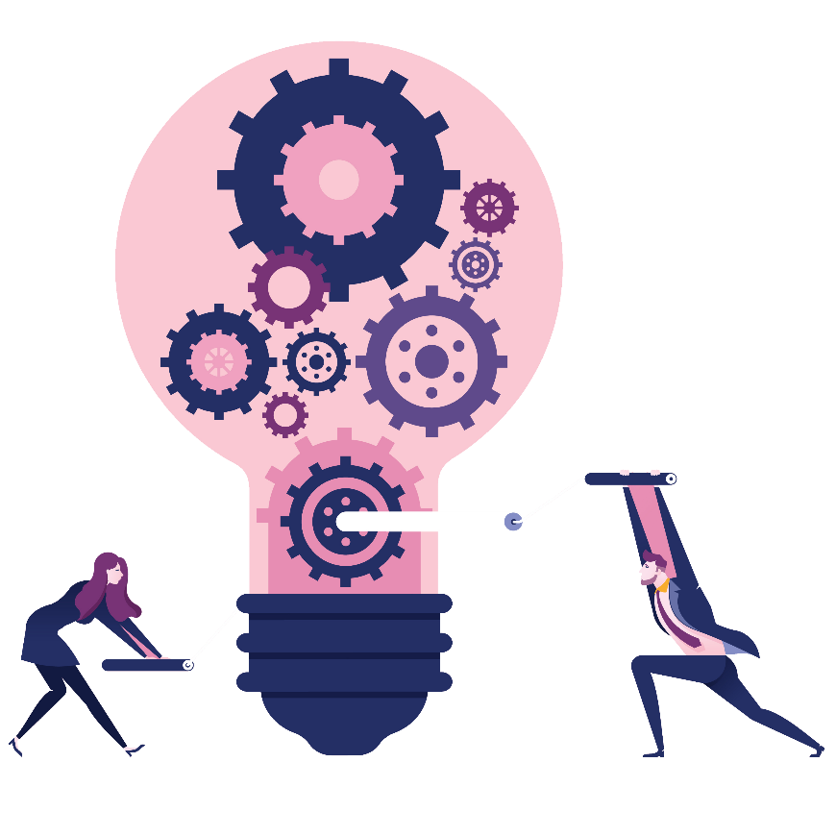
Calling Functions
Syntax
Example
Output

Slide 8
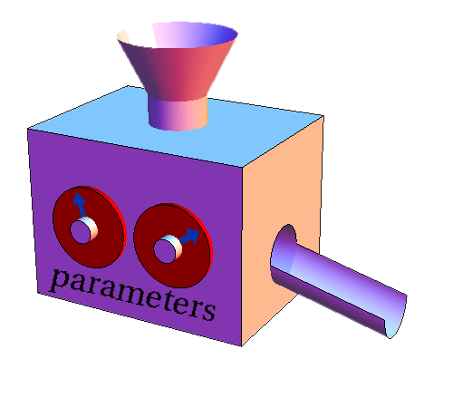

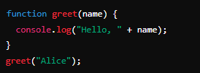
Function Parameters
Definition
Parameters are placeholders for values (arguments) passed to the function
Syntax
Example
Output
?

Slide 9

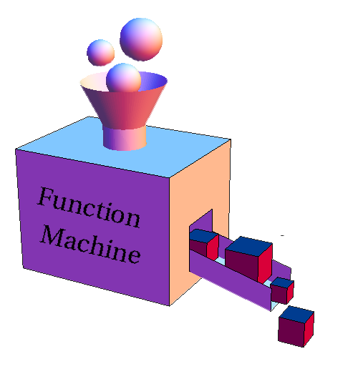
Multiple Parameters
Definition
Parameters are placeholders for values (arguments) passed to the function
Example
Output
?

Slide 10

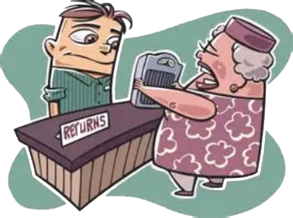
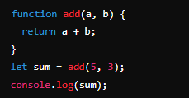
Return Values
Definition
The value a function returns to the caller using the return statement
Syntax
Example
Output
?

Slide 11
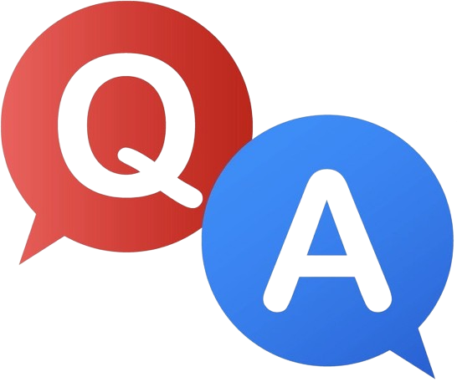

Slide 12

What is a function?
How do you define and call a function in JavaScript?
What are parameters and return values?

Slide 13
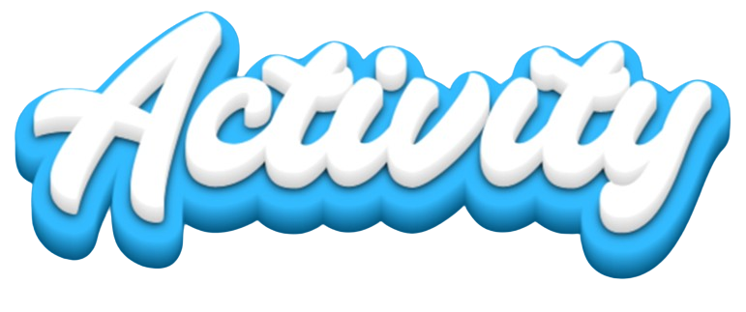
Task 1
Create a function that takes two numbers and returns their difference
Task 2
Call the function with different sets of arguments and log the results

